Slide 1
Activity Diagram
UML diagram

Slide 2
Activity Diagrams
Activity diagram shows flow of control or object flow with emphasis on the sequence and conditions of the flow.
The actions coordinated by activity models can be initiated
because other actions finish executing,
because objects and data become available,
or because some events external to the flow occur.
UML activity diagrams elements:
activity,
partition,
action,
object,
control,
activity edge.

Slide 3
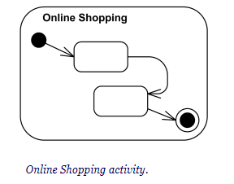
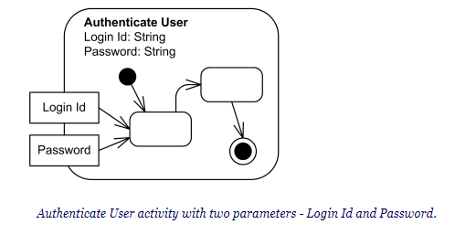
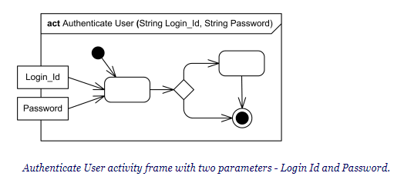
Activity
Activity is a parameterized behavior represented as coordinated flow of actions.
It can be a simple action or a complex set of actions.
Example: In a software development process, "Design Database Schema" is an activity. It can be further decomposed into sub-activities like "Create Entity-Relationship Diagram" and "Define Table Structures.“
Activity nodes also include flow of control constructs, such as synchronization, decision, and concurrency control.
Activity contains activity nodes which could be:
action
object
control

Slide 4
Example
Let's consider the process of making a sandwich as an activity:
Gather Ingredients
Prepare Bread
Add Condiments
Add Fillings
Combine Slices
Activity Diagram Connection
Represent each of these steps as "activity nodes.“
The arrows or lines connecting these nodes indicate the flow of the process.
Symbols like diamonds to represent decisions, which help determine whether to add condiments or not, for instance.
Parameterized Behavior (parameter-name: parameter-type.)
When you're adding cheese to your sandwich, you might specify the type of cheese you want (parameter)
These parameters help customize the behavior of an action
Preconditions and Postconditions ( «precondition» and «postcondition»)
there's a precondition - you need to have all the ingredients
there's a postcondition - you have a sandwich to eat.
Single Execution («singleExecution»)
it's a single shared execution because you're making one sandwich.
In contrast, imagine a chef in a restaurant preparing multiple sandwiches - each customer's order is a separate execution

Slide 5
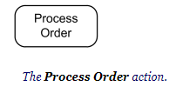
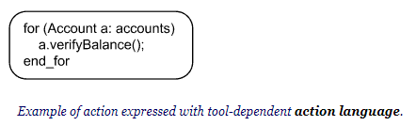
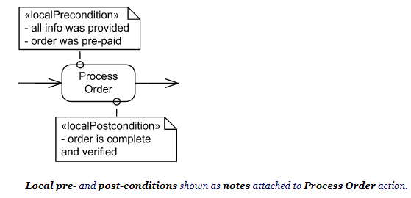
Actions
Action is a named element which represents a single atomic step within activity, i.e. that is not further decomposed within the activity.
Activity represents a behavior that is composed of individual elements that are actions.
Name of the action is usually action verb or noun for the action with some explanation
Fill Order
Review Document
Enroll in Course
Checkout
Show Error Page
An action may have sets of incoming and outgoing activity edges that specify control flow and data flow from and to other nodes.

Slide 6
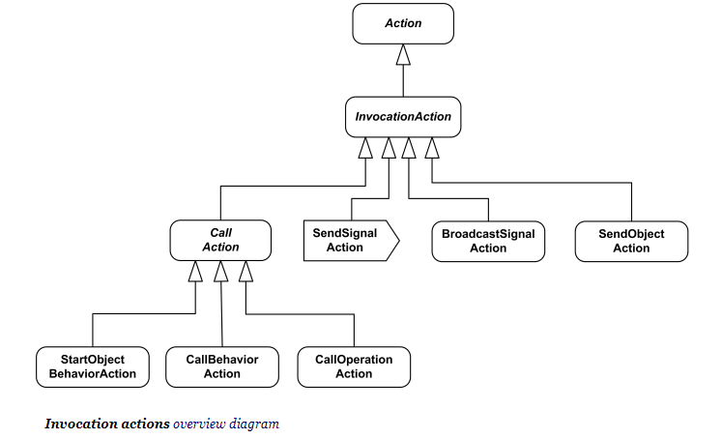
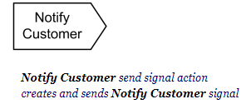
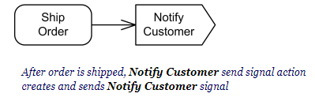
Actions Subclasses
Object action (not explicit in UML standard) - include different actions on objects, e.g. create and destroy object, test object identity, specify value, etc.
Variable action - variable read, write, add, remove and clear actions
Invocation action - several call actions, signal send and broadcast actions and send object action
Call behavior action is a call action that invokes a behavior directly rather than invoking an operation that invokes the behavior.
synchronous calls, asynchronous
Send signal action is an invocation action that creates a signal from its inputs, and transmits it to the specified target object, where it may cause the firing of a state machine transition or the execution of an activity.
Raise exception action
Structural feature action
Link action
Event action (not explicit in UML standard)
Opaque action

Slide 7
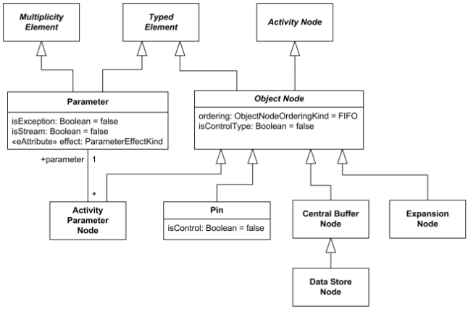
Object Nodes
An object node is an abstract activity node that is used to define object flows in an activity.
Object nodes include pin, central buffer, parameter, expansion nodes.

Slide 8
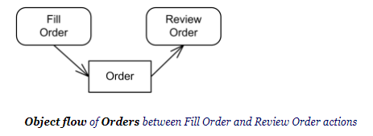
Object Node
It indicates that an instance of a particular classifier, possibly in a particular state, may be available at a particular point in the activity.
Object nodes are notated as rectangles.

Slide 9
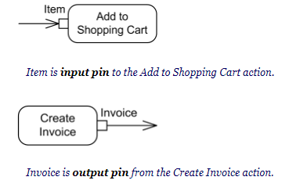
Pin
A pin is an object node for inputs and outputs to actions.
Pin is usually shown as a small rectangle attached to the action rectangle. The name of the pin can be displayed near the pin.

Slide 10
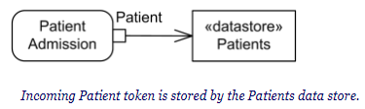
Central Buffer
A central buffer node is an object node for managing flows from multiple sources and destinations.
A central buffer node accepts tokens from multiple object in flows, buffers those and passes them along to out flows.
Central buffer is notated as an object node with optional keyword «centralBuffer» which allows to distinguish it from the standalone pin.
A data store is a central buffer node for non-transient information

Slide 11
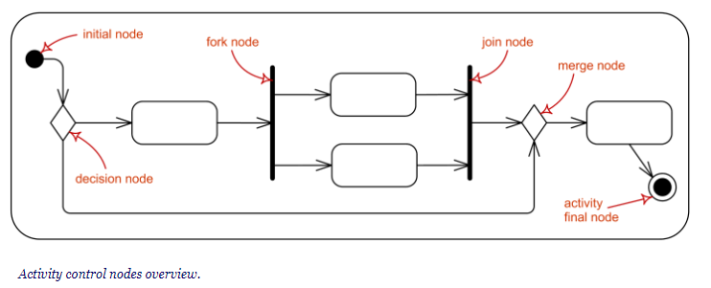
Controls
Control node is an activity node used to coordinate the flows between other nodes. It includes:
initial node
flow final node
activity final node
decision node
merge node
fork node
join node

Slide 12

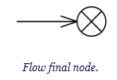

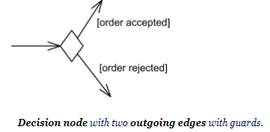
Initial node is a control node at which flow starts when the activity is invoked.
Activities may have more than one initial node. In this case, invoking the activity starts multiple flows, one at each initial node.
Flow final node is a control final node that terminates a flow. It destroys all tokens that arrive at it but has no effect on other flows in the activity.
Activity final node is a control final node that stops all flows in an activity.
An activity may have more than one activity final node. The first one reached stops all flows in the activity
Decision node is a control node that accepts tokens on one or two incoming edges and selects one outgoing edge from one or more outgoing flows.

Slide 13
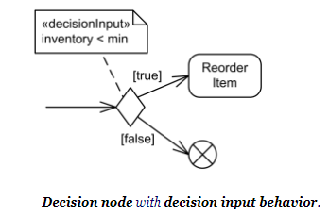
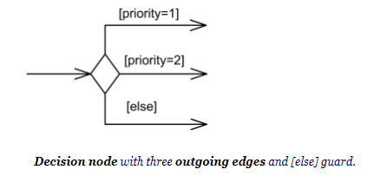
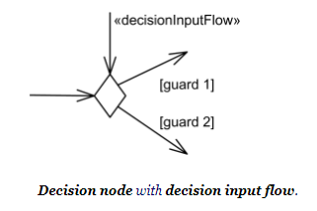

Slide 14
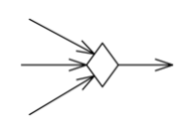


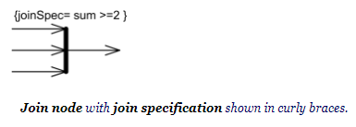
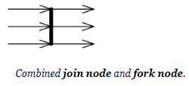
Merge node is a control node that brings together multiple incoming alternate flows to accept single outgoing flow. There is no joining of tokens. Merge should not be used to synchronize concurrent flows.
Fork node is a control node that has one incoming edge and multiple outgoing edges and is used to split incoming flow into multiple concurrent flows. Fork nodes are introduced to support parallelism in activities.
Join node is a control node that has multiple incoming edges and one outgoing edge and is used to synchronize incoming concurrent flows.

Slide 15
Activity Partition
An activity partition is activity group for actions that have some common characteristic.
Activity partition may be shown using a swimlane notation - with two, usually parallel lines, either horizontal or vertical, and a name labeling the partition in a box at one end.
Partitions provide a constrained view on the behaviors invoked in activities. The following constraints are normative (standard) in UML 2.4:
classifier
instance
part
attribute and value

Slide 16
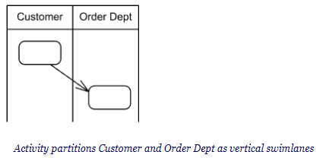
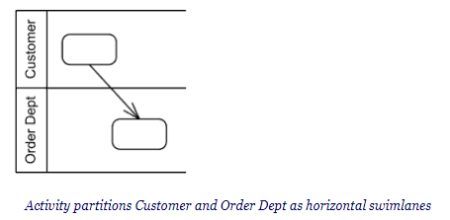
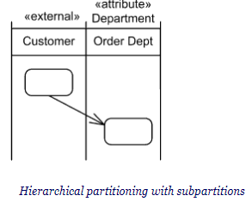
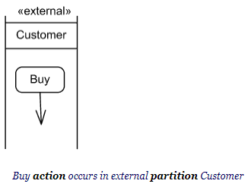
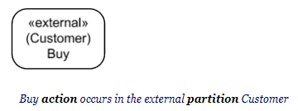

Slide 17
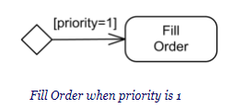
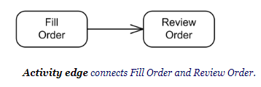
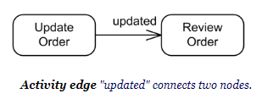
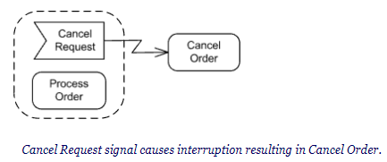
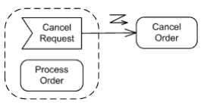
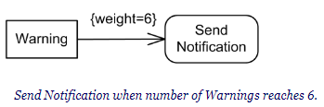
Activity Edge
Activity Edge is an abstract class for the directed connections along which tokens or data objects flow between activity nodes.

Slide 18
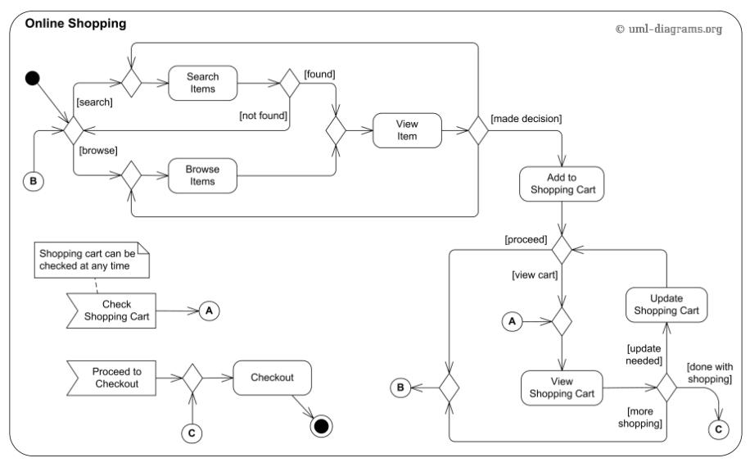
Online Shopping

Slide 19
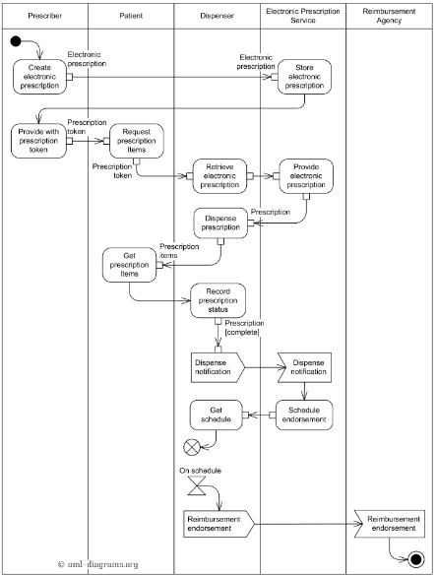
Electronic Prescriptions

